Slide 1
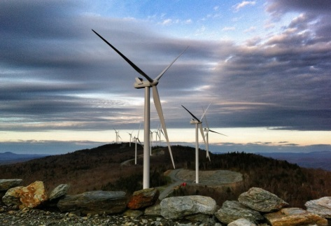
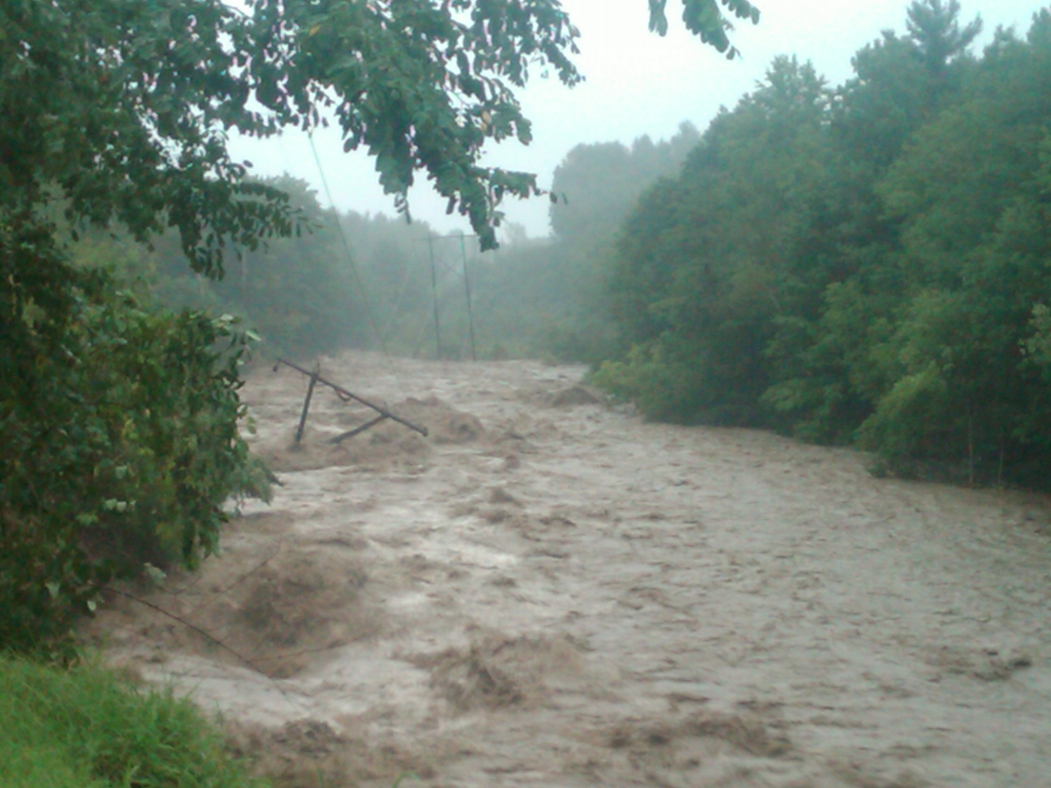
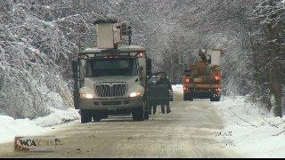
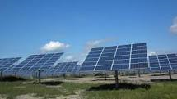
Vermont Weather Analytics Center Project
Kerrick Johnson
VP—Strategy & Communication
kjohnson@velco.com
(802) 770-6166

Slide 2
Weather forecasting tools
Global
Global forecast models → GFS, European, Canadian, etc.
Climate trends → El Nino, La Nina, etc.
Regional
Regional forecast models → NAM
Local
High Resolution:
Deep Thunder

Slide 3
Project overview
Two-year, $16M research undertaking to develop intellectual property using coupled data models and related software. Its purpose is to increase grid reliability, lower weather event-related operational costs and optimize utilization of renewable generation resources.
Uses four models:
Deep Thunder: to produce accurate weather forecasts up to 48 hours in advance down to 1 sq km—lower weather event costs
Demand Forecast Model: to increase accuracy of state load forecasts—better plan for future needs
Renewable Forecast Model: to produce generation forecasts for solar and wind farms—improve power supply/planning
Renewable Integration Stochastic Engine (RISE): to integrate the models’ results to optimize the value of Vermont's generation, demand response, and transmission assets

Slide 4
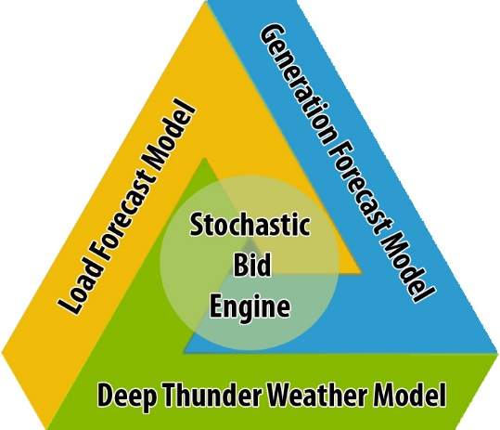
VELCO-IBM
Vermont Weather Analytics Center
Notes:
Increased effectiveness and lower-cost weather event assessment, preparation, response and customer service restoration from increasingly severe and frequent weather events.
VEC/GMP combined storm costs for 2013 alone were $22 million, $33million 2104.
Bolstered advocacy at ISO-NE for non-transmission alternatives through provision of accurate, real-time data on renewable generation sources.
The total project cost equals $400 million worth of transmission project deferrals secured out of a possible $4.8 billion in currently anticipated regional transmission costs.
Predictive modeling of wind/solar generation resources helps renewables integration and load balancing to maintain system reliability.
Improved forecasting of intermittent wind and solar renewable resources could potentially be worth $1 million to $4 million annually to New England and several hundred thousand dollars to Vermont.
Keep people safer, save customers money, improve ecosystem

Slide 5
Vermont Weather Analytics Center (VTWAC) Partners
Vermont Distribution Utilities
Vermont College/ University
Other Vermont Organizations
Notes:
lower Vermonters’ energy expenses,
increase opportunities for economic growth and jobs, and export of Vermont technical expertise
enhance our environment, and
secure greater energy independence.

